Slide 1
DRQ: Dynamic Region-based Quantization for Deep Neural Network Acceleration
Zhuoran Song, Bangqi Fu, Feiyang Wu, Zhaoming Jiang, Li Jiang, Naifeng Jing, Xiaoyao Liang
2020 ACM/IEEE 47th Annual International Symposium on Computer Architecture (ISCA)

Slide 2
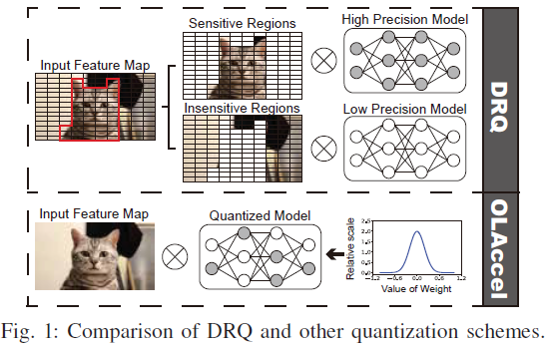
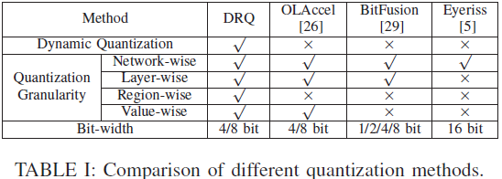
Motivation
Conventional: Network/Layer-wise > fine-grained quantization
Capture the feature map dynamics > performance & accuracy

Slide 3
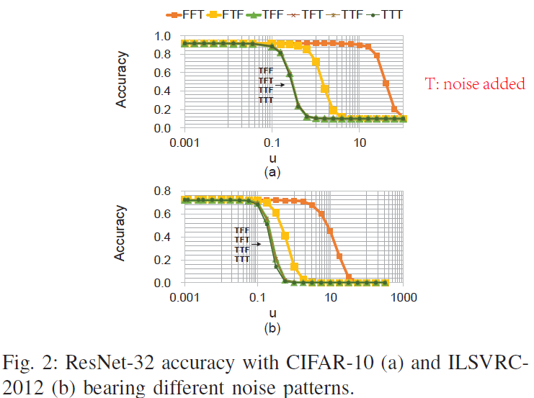
motivation: identify
Sensitivity values
Classify the input feature map: 3 segments
Segment 0: largest 20%
Segment 1: Middle 60%
Segment 2: Smallest 20%
TFF: segment 0 added noise
Add noise μ on different segment Measure accuracy by varying μ
The largest set of values in the input feature map are relatively more sensitive to the accuracy.

Slide 4
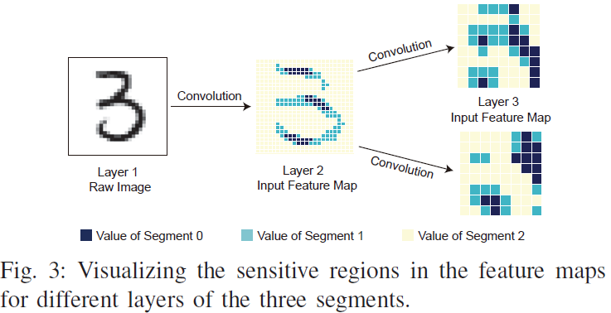
motivation: identify
Sensitive regions
Inference and Visualize
LeNet-5 MINIST
Segment 0 tends to aggregate in space
forming several sensitive regions.

Slide 5
Problems
How to identify the sensitive regions at runtime
Efficient and hardware friendly
Unlike weights learned offline
How to conduct an efficient input sensitivity aware convolution
Intra-layer & Multi-precision quantization
Fine-grained control to reduce workload and benefit performance
A dynamic feature map region-based quantization - a software and hardware co-design scheme

Slide 6
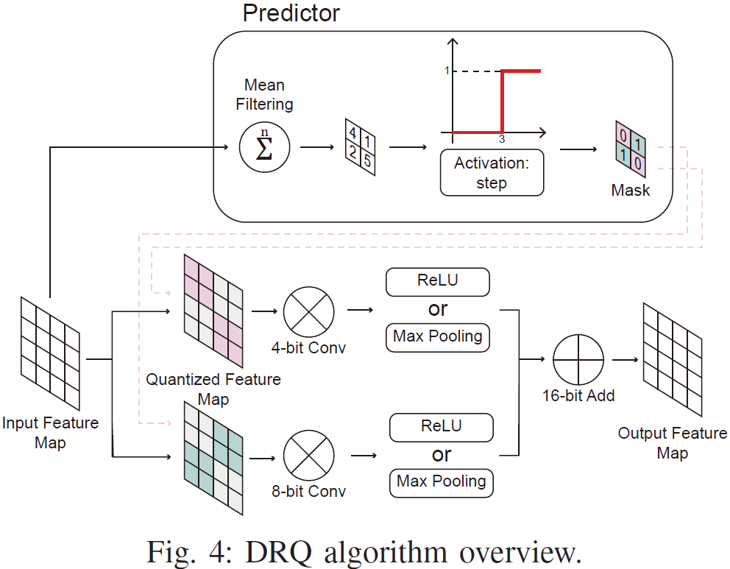
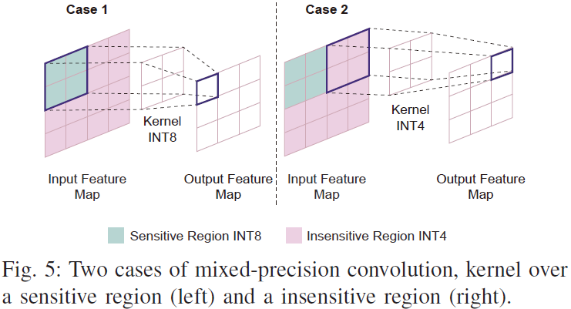
Methods: Algorithm
Overview:
Sensitivity prediction
FP32 to INT8
Split and Mean Filtering
Binary map generation
Mixed-precision quantization
8bit Conv: Sensitive regions
4bit Conv: Insensitive regions
(clip the precision of kernel weights)
Design Space exploration
Number of sensitive regions: performance vs accuracy
Size of sensitive regions:
coarse-grained/fine-grained
hardware-friendly/accuracy-friendly
Trial-and-error: retrain and evaluate

Slide 7
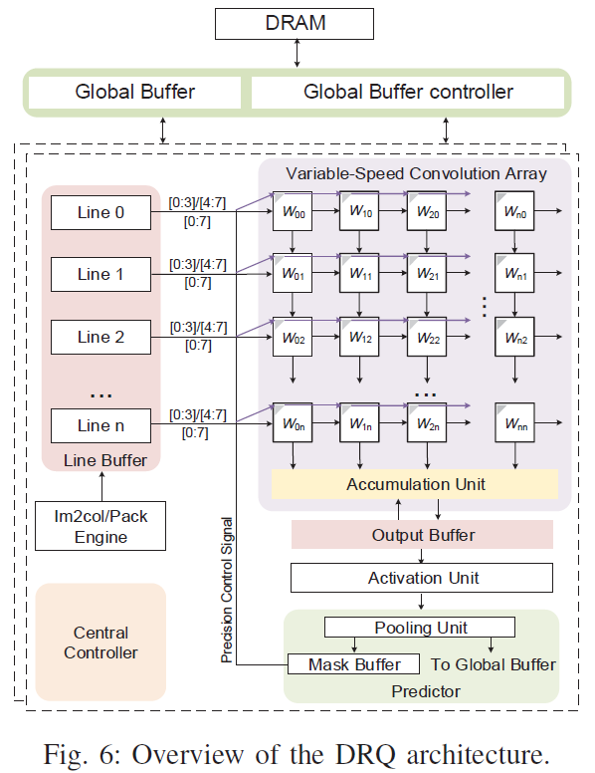
Methods: architecture
Several PE pages
Each PE page:
a line buffer, a mixed-precision convolution array, an accumulation unit, an output buffer, an activation and pooling unit, a sensitivity predictor and the associated control logic
Im2col/Pack Engine: Transform and Pack
Data packing: According to binary mask map: insensitive > 4bit reg; sensitive > 8bit reg

Slide 8
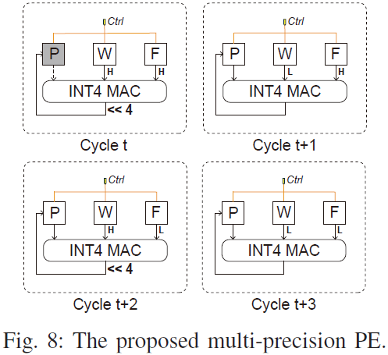
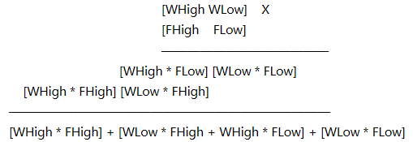
Methods: architecture
Multi-precision PE:
W, F: 8bit reg P: 16bit reg

Slide 9
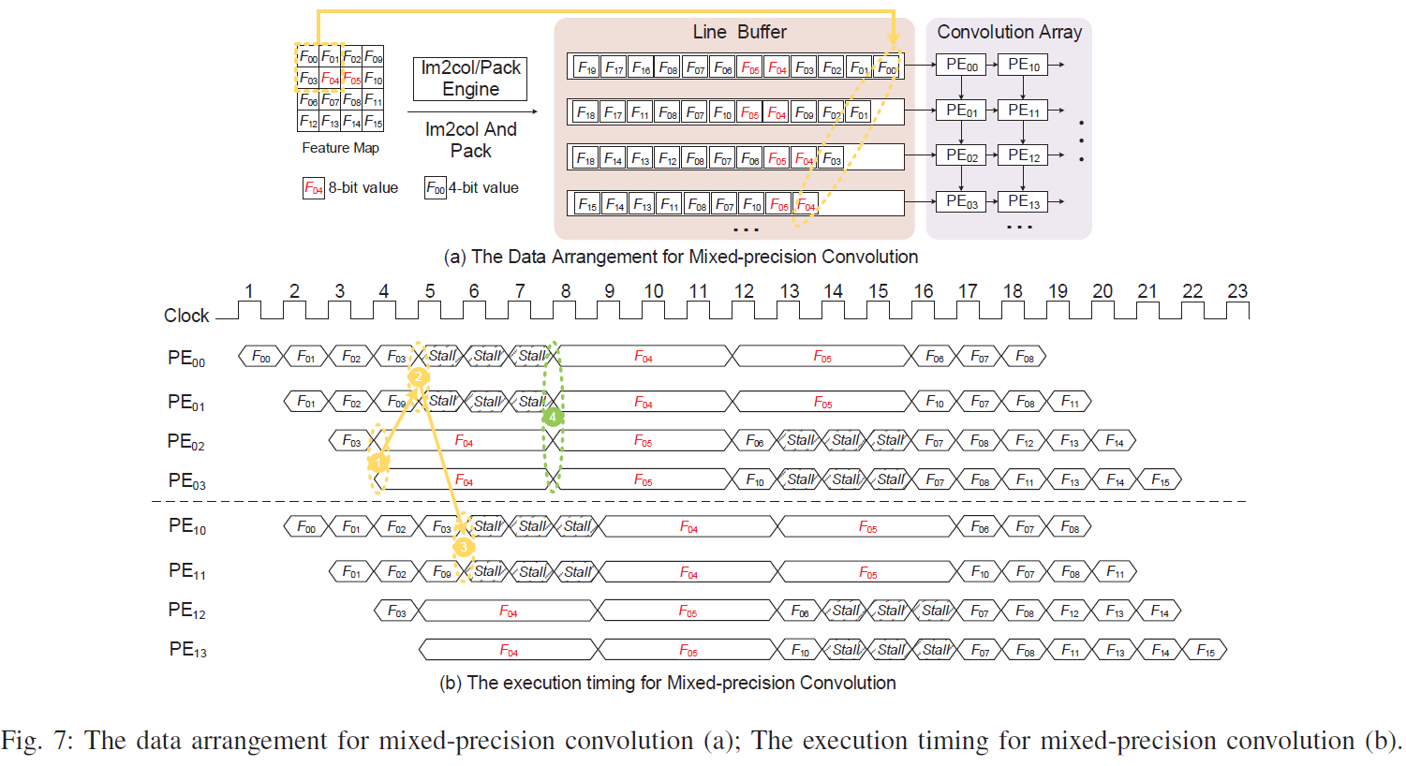
Methods: Architecture
Systolic: lag one cycle
Red: 8bit Reg
Red: 8bti Conv > 3 more cycles > 3 bubbles (stall)

Slide 10
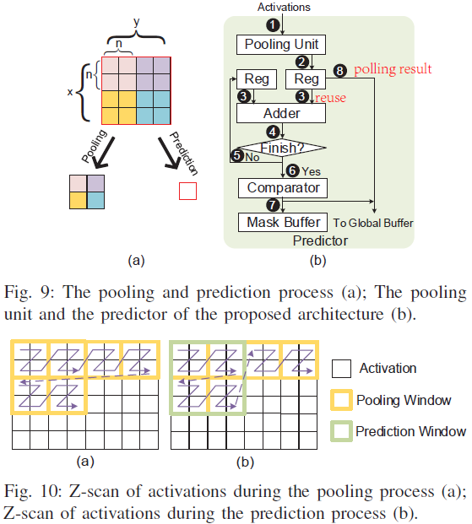
Methods: architecture
Design details:
Activation-pooling-prediction
Average pooling: data reuse
Other operations: no step 8
Dual-buffering scheme
Support variable kernel sizes

Slide 11
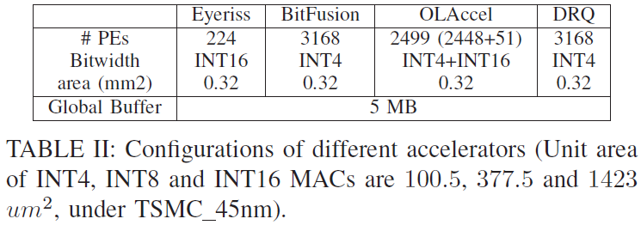
Results: configuration
Fair comparison: similar area budget, same global buffer capacity & memory bandwidth
INT16 MAC unit is almost 16X larger than an INT4 MAC unit

Slide 12
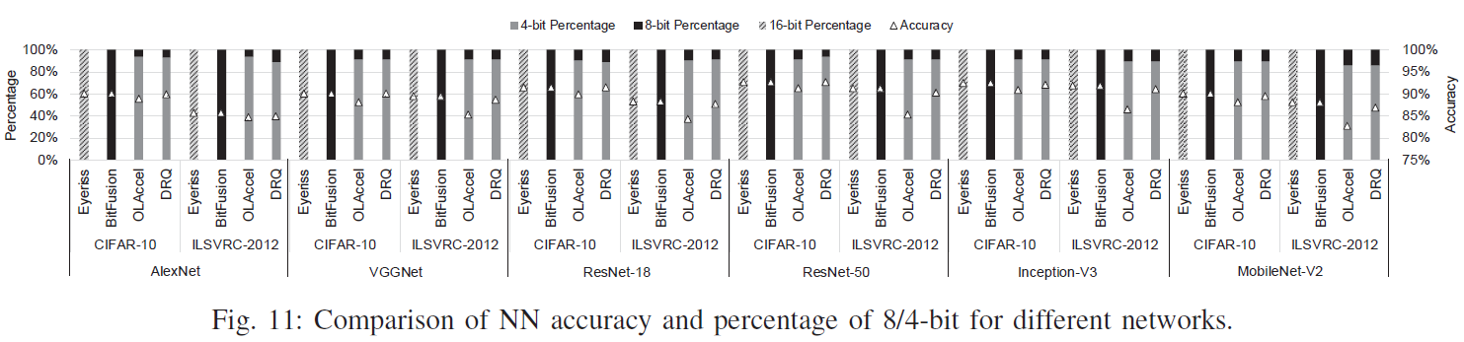
Results: accuracy
DRQ & OLAccel: Mixed precision
OLAccel: Static, bit configuration predefined, fixed across all layers and datasets
DRQ: Dynamic, feature map predictor, vary from time to time
0.7% vs 5.1%
0.9% vs 5.4%

Slide 13
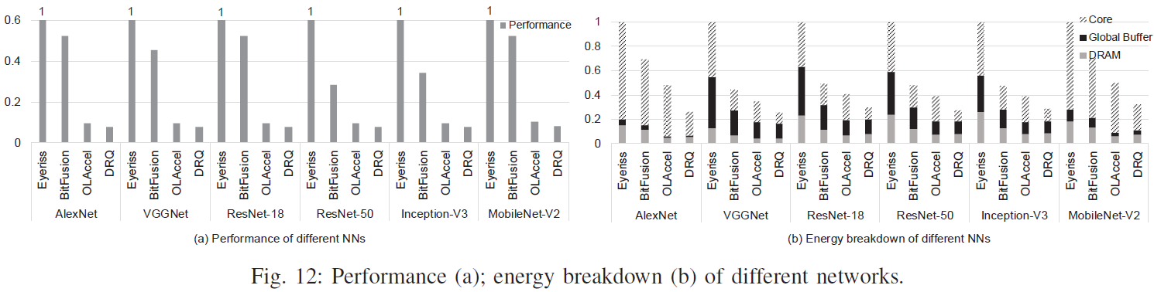
RESULTS: PERFORMANCE & Energy
Normalized to Eyeriss, Example: ResNet-50
DRQ vs Eyeriss & BitFusion:
93% & 73% performance improvement: mainly INT4 MACs
72% & 43% less energy: reduced bit width/data transfer
DRQ vs OLAccel:
20% performance improvement: more PEs under the same area budget
OLAccel: 5% accuracy loss on ILSVRC-2012.
More energy from DRAM: weight stored in INT8 vs most INT4
Similar energy from global buffer: weight stationary
Less energy from core: systolic array processing

Slide 14
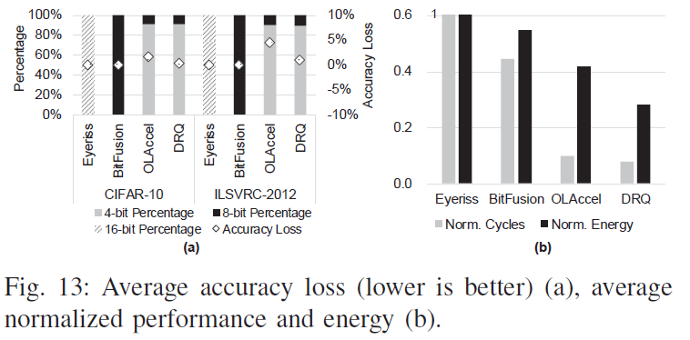
RESULTS: AVERAGE OF 6 NETWORKS

Slide 15
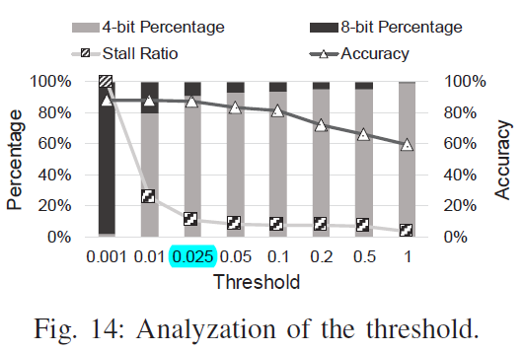
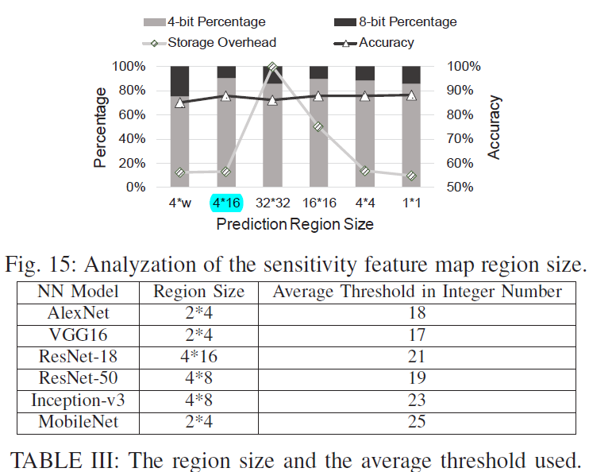
Results: Design space exploration
Impact of threshold
Impact of region size
Offline study, set at runtime
Res18 as example:
Higher threshold > Less sensitive regions > lower stall ratio
4*4 > sensitivity affected by noise > accuracy degradation
32*32 > unnecessary sensitive > unnecessary INT8

Slide 16
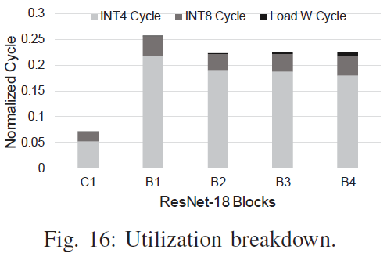
RESULTS: PERFORMANCE BREAKDOWN
Normalized to the total execution cycles
C1: more sensitive, INT8 ratio 12%
B4: smaller feature map size, weight loading 4%

